Slide 1
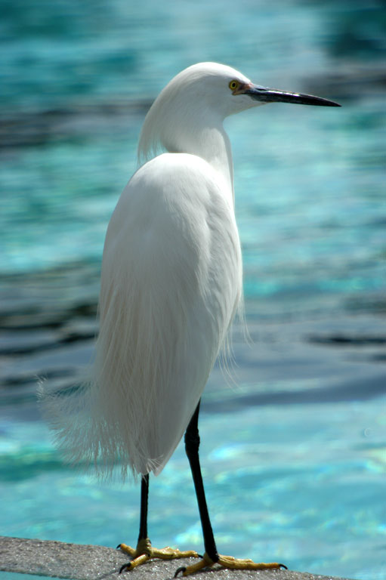
Assigment – Điện toán đám mây:
Sinh viên : Nguyễn Thanh TÙng
Mã sv : tungntph04044
Notes:
Custom animation effects: duplicate picture with varied brightness to full color
(Advanced)
Tip: For the effects on this slide, use a picture with a “portrait” (vertical) orientation.
To reproduce the text effects on this slide, do the following:
On the Home tab, in the Slides group, click Layout, and then click Blank.
On the Insert tab, in the Text group, click Text Box, and then on the slide, drag to draw the text box.
Enter text in the text box, and then select the text. On the Home tab, in the Font group, select Georgia from the Font list, enter 34 in the Font Size box, click Italic, click the arrow next to Font Color, and then under Theme Colors click Aqua, Accent 5, Darker 25% (fifth row, ninth option from the left).
Drag the text box into the upper half of the slide, slightly left of the center.
To reproduce the first picture with animation effects on this slide, do the following:
On the Insert tab, in the Illustrations group, click Picture. In the Insert Picture dialog box, select a picture and then click Insert.
On the slide, select the picture. Under Picture Tools, on the Format tab, in the bottom right corner of the Size group, click the Size and Position dialog box launcher. In the Size and Position dialog box, on the Size tab, resize or crop the picture as needed so that under Size and rotate, the Height box is set to 3.81” and the Width box is set to 2.54”. Resize the picture under Size and rotate by entering values into the Height and Width boxes. Crop the picture under Crop from by entering values into the Left, Right, Top, and Bottom boxes.
Drag the picture into the into the top left corner of the slide. (Note: Align the left edge of the picture with the left edge of the slide, and leave a small margin between the top edge of the picture and the top edge of the slide.)
Select the picture. Under Picture Tools, on the Format tab, in the bottom right corner of the Picture Styles group, click the Format Shape dialog box launcher.
In the Format Picture dialog box, in the left pane, click Picture, and then do the following in the Picture pane:
Click the button next to Recolor, and then select the recolor option that works best with the picture. (Note: The first picture in the example above is set to No Recolor.)
In the Brightness box, enter 50%. (Note: You may want to adjust the brightness settings for the picture you have chosen.)
On the Animations tab, in the Animations group, click Custom Animation.
On the slide, select the picture, and then do the following in the Custom Animation task pane:
Click Add Effect, point to Entrance, and then click More Effects. In the Add Entrance Effect dialog box, under Basic, click Fly In, and then click OK.
Under Modify: Fly In, in the Start list, select With Previous.
Under Modify: Fly In, in the Direction list, select From Left.
Under Modify: Fly In, in the Speed list, select Fast.
Click Add Effect, point to Entrance, and then click More Effects. In the Add Entrance Effect dialog box, under Subtle, click Expand, and then click OK.
Under Modify: Expand, in the Start list, select With Previous.
Under Modify: Expand, in the Speed list, select Fast.
To reproduce the second picture with animation effects on this slide, do the following:
On the slide, select the picture. On the Home tab, in the Clipboard group, click the arrow under Paste, and then click Duplicate.
Drag the second picture until the left side slightly overlaps the right side of the first picture.
Select the second picture. Under Picture Tools, on the Format tab, in the bottom right corner of the Picture Styles group, click the Format Shape dialog box launcher.
In the Format Picture dialog box, in the left pane, click Picture. In the Picture pane, in the Brightness box, enter 40%. (Note: You may want to adjust the brightness settings for the picture you have chosen.)
Press and hold CTRL, and then select the third and fourth animation effects (fly-in and expand effects for the second picture) in the Custom Animation task pane. Click the arrow to the right of one of the animation effects, and then click Timing. In the Effect Options dialog box, on the Timing tab, in the Delay box, enter 0.2, and then click OK.
To reproduce the third picture with animation effects on this slide, do the following:
On the slide, select the second picture. On the Home tab, in the Clipboard group, click the arrow under Paste, and then click Duplicate.
Drag the third picture until its left side slightly overlaps the right side of the second picture.
Select the third picture. Under Picture Tools, on the Format tab, in the bottom right corner of the Picture Styles group, click the Format Shape dialog box launcher.
In the Format Picture dialog box, in the left pane, click Picture. In the Picture pane, in the Brightness box, enter 20%. (Note: You may want to adjust the brightness settings for the picture you have chosen.)
Press and hold CTRL, and then select the fifth and sixth animation effects (fly-in and expand effects for the third picture) in the Custom Animation task pane. Click the arrow to the right of one of the animation effects, and then click Timing. In the Effect Options dialog box, on the Timing tab, in the Delay box, enter 0.4, and then click OK.
To reproduce the fourth picture with animation effects on this slide, do the following:
On the slide, select the third picture. On the Home tab, in the Clipboard group, click the arrow under Paste, and then click Duplicate.
Drag the fourth picture until its left side slightly overlaps the right side of the third picture.
Select the fourth picture. Under Picture Tools, on the Format tab, in the bottom right corner of the Picture Styles group, click the Format Shape dialog box launcher.
In the Format Picture dialog box, in the left pane, click Picture. In the Picture pane, in the Brightness box, enter 0%.
Press and hold CTRL, and then select the seventh and eighth animation effects (fly-in and expand effects for the fourth picture) in the Custom Animation pane. Click the arrow to the right of one of the animation effects, and then click Timing. In the Effect Options dialog box, on the Timing tab, in the Delay box, enter 0.6, and then click OK.
To reproduce the fifth picture with animation effects on this slide, do the following:
On the slide, select the fourth picture. On the Home tab, in the Clipboard group, click the arrow under Paste, and then click Duplicate.
Drag the fifth picture until its left side slightly overlaps the right side of the fourth picture.
Select the fifth picture. Under Picture Tools, on the Format tab, in the bottom right corner of the Picture Styles group, click the Format Shape dialog box launcher.
In the Format Picture dialog box, in the left pane, click Picture. In the Picture pane, click the button next to Recolor, and then under No Recolor click No Recolor.
Press and hold CTRL, and then select the ninth and 10th animation effects (fly-in and expand effects for the fifth picture) in the Custom Animation task pane. Click the arrow to the right of one of the selected animation effects, and then click Timing. In the Effect Options dialog box, on the Timing tab, in the Delay box, enter 0.8, and then click OK.
To reproduce the animation effects for the text box on this slide, do the following:
On the Home tab, in the Editing group, click Select, and then click Selection Pane.
In the Selection and Visibility pane, select the text box, and then do the following in the Custom Animation task pane:
Click Add Effect, point to Entrance, and then click More Effects. In the Add Entrance Effect dialog box, under Subtle, click Fade, and then click OK.
Under Modify: Fade, in the Start list, select With Previous.
Under Modify: Fade, in the Speed list, select Very Fast.
In the Selection and Visibility pane, press and hold CTRL, and then select the first, second, third, and fourth pictures. In the Custom Animation task pane do the following:
Click Add Effect, point to Exit, and then click More Effects. In the Add Exit Effect dialog box, under Moderate, click Stretchy, and then click OK.
Under Modify: Stretchy, in the Start list, select With Previous.
Under Modify: Stretchy, in the Speed list, select Fast.
Also in the Custom Animation task pane, select the 12th animation effect (first stretchy effect for the text box). Click the arrow to the right of the animation effect, and then click Timing. In the Stretchy dialog box, on the Timing tab, in the Delay box, enter 1.4, and then click OK.
Also in the Custom Animation task pane, select the 13th animation effect (second stretchy effect for the text box). Click the arrow to the right of the animation effect, and then click Timing. In the Stretchy dialog box, on the Timing tab, in the Delay box, enter 1.6, and then click OK.
Also in the Custom Animation task pane, select the 14th animation effect (third stretchy effect for the text box). Click the arrow to the right of the animation effect, and then click Timing. In the Stretchy dialog box, on the Timing tab, in the Delay box, enter 1.8, and then click OK.
Also in the Custom Animation task pane, select the 15th animation effect (fourth stretchy effect for the text box). Click the arrow to the right of the animation effect, and then click Timing. In the Stretchy dialog box, on the Timing tab, in the Delay box, enter 2.0, and then click OK.
To reproduce the background effects on this slide, do the following:
Right-click the slide background area, and then click Format Background. In the Format Background dialog box, click Fill in the left pane, select Gradient fill in the right pane, and then do the following:
In the Type list, select Radial.
Click the button next to Direction, and then click From Center (third option from the left).
Under Gradient stops, click Add or Remove until three stops appear in the drop-down list.
Also under Gradient stops, customize the gradient stops as follows:
Select Stop 1 from the list, and then do the following:
In the Stop position box, enter 0%.
Click the button next to Color, and then under Theme Colors click White, Background 1, Darker 5% (second row, first option from the left).
Select Stop 2 from the list, and then do the following:
In the Stop position box, enter 34%.
Click the button next to Color, and then under Theme Colors click White, Background 1, Darker 15% (third row, first option from the left).
Select Stop 3 from the list, and then do the following:
In the Stop position box, enter 100%.
Click the button next to Color, and then under Theme Colors click White, Background 1, Darker 50% (sixth row, first option from the left).

Slide 2
I. Mô tả vấn đề
Yêu cầu : Cửa hàng quần áo TT đặt hàng yêu cầu tôi xây dựng 1 hệ thống quản lý bán các loại quần , áo , mũ , giày khác nhau và yêu cầu tôi xây dựng mô hình database trên vertabelo.
Notes:
Custom animation effects: Grayscale picture fades to full color
(Basic)
To reproduce the grayscale picture effects on this slide, do the following:
On the Home tab, in the Slides group, click Layout, and then click Blank.
On the Insert tab, in the Illustrations group, click Picture. In the Insert Picture dialog box, select a color picture and then click Insert.
On the slide, select the picture. Under Picture Tools, on the Format tab, in the bottom right corner of the Size group, click the Size and Position dialog box launcher. In the Size and Position dialog box, on the Size tab, resize or crop the picture as needed so that under Size and rotate, the Height box is set to 4.15” and the Width box is set to 6.25”. Resize the picture under Size and rotate by entering values into the Height and Width boxes. Crop the picture under Crop from by entering values into the Left, Right, Top, and Bottom boxes.
Under Picture Tools, on the Format tab, in the Adjust group, click Recolor, and then under Color Modes click Grayscale (first option from the left).
Right-click the grayscale picture, and then click Format Picture. In the Format Picture dialog box, in the left pane, click Shadow. In the Shadow pane, click the button next to Presets, and then under Outer click Offset Diagonal Top Right (third row, first option on the left).
On the Home tab, in the Drawing group, click Arrange, point to Align, and then do the following:
Click Align to Slide.
Click Align Middle.
Click Align Center.
To reproduce the full-color picture effects on this slide, do the following:
Select the grayscale picture. On the Home tab, in the Clipboard group, click the arrow under Paste, and then click Duplicate.
Select the duplicate picture. Under Picture Tools, on the Format tab, in the Adjust group, click Recolor, and then under No Recolor click No Recolor.
On the Home tab, in the Drawing group, click Arrange, point to Align, and then do the following:
Click Align to Slide.
Click Align Middle.
Click Align Center.
To reproduce the animation effects on this slide, do the following:
On the Animations tab, in the Animations group, click Custom Animation.
On the slide, select the full-color picture, and then do the following in the Custom Animation task pane:
Click Add Effect, point to Entrance, and then click More Effects. In the Add Entrance Effect dialog box, under Subtle, click Fade, and then click OK.
Under Modify: Fade, in the Start list, select With Previous.
Under Modify: Fade, in the Speed list, select Slow.
Click Add Effect, point to Entrance, and then click More Effects. In the Add Entrance Effect dialog box, under Subtle, click Expand, and then click OK.
Under Modify: Expand, in the Start list, select With Previous.
Under Modify: Expand, in the Speed list, select Fast.
To reproduce the background effects on this slide, do the following:
On the Design tab, in the Background group, click Background Styles, and then click Style 8 (second row, fourth option from the left). (Note: If this action is taken in a PowerPoint presentation containing more than one slide, the background style will be applied to all of the slides.)

Slide 3
II. Mô tả vấn đề
- hệ thống lưu thông tin khách
+ Chỉnh sửa thông tin khách hàng nếu sai
+ Tạo hóa đơn cho khách hàng
+ Chỉnh sửa hóa đơn nếu sai
+ Xuất hóa đơn cho khách hàng
Notes:
Custom animation effects: Grayscale picture fades to full color
(Basic)
To reproduce the grayscale picture effects on this slide, do the following:
On the Home tab, in the Slides group, click Layout, and then click Blank.
On the Insert tab, in the Illustrations group, click Picture. In the Insert Picture dialog box, select a color picture and then click Insert.
On the slide, select the picture. Under Picture Tools, on the Format tab, in the bottom right corner of the Size group, click the Size and Position dialog box launcher. In the Size and Position dialog box, on the Size tab, resize or crop the picture as needed so that under Size and rotate, the Height box is set to 4.15” and the Width box is set to 6.25”. Resize the picture under Size and rotate by entering values into the Height and Width boxes. Crop the picture under Crop from by entering values into the Left, Right, Top, and Bottom boxes.
Under Picture Tools, on the Format tab, in the Adjust group, click Recolor, and then under Color Modes click Grayscale (first option from the left).
Right-click the grayscale picture, and then click Format Picture. In the Format Picture dialog box, in the left pane, click Shadow. In the Shadow pane, click the button next to Presets, and then under Outer click Offset Diagonal Top Right (third row, first option on the left).
On the Home tab, in the Drawing group, click Arrange, point to Align, and then do the following:
Click Align to Slide.
Click Align Middle.
Click Align Center.
To reproduce the full-color picture effects on this slide, do the following:
Select the grayscale picture. On the Home tab, in the Clipboard group, click the arrow under Paste, and then click Duplicate.
Select the duplicate picture. Under Picture Tools, on the Format tab, in the Adjust group, click Recolor, and then under No Recolor click No Recolor.
On the Home tab, in the Drawing group, click Arrange, point to Align, and then do the following:
Click Align to Slide.
Click Align Middle.
Click Align Center.
To reproduce the animation effects on this slide, do the following:
On the Animations tab, in the Animations group, click Custom Animation.
On the slide, select the full-color picture, and then do the following in the Custom Animation task pane:
Click Add Effect, point to Entrance, and then click More Effects. In the Add Entrance Effect dialog box, under Subtle, click Fade, and then click OK.
Under Modify: Fade, in the Start list, select With Previous.
Under Modify: Fade, in the Speed list, select Slow.
Click Add Effect, point to Entrance, and then click More Effects. In the Add Entrance Effect dialog box, under Subtle, click Expand, and then click OK.
Under Modify: Expand, in the Start list, select With Previous.
Under Modify: Expand, in the Speed list, select Fast.
To reproduce the background effects on this slide, do the following:
On the Design tab, in the Background group, click Background Styles, and then click Style 8 (second row, fourth option from the left). (Note: If this action is taken in a PowerPoint presentation containing more than one slide, the background style will be applied to all of the slides.)

Slide 4
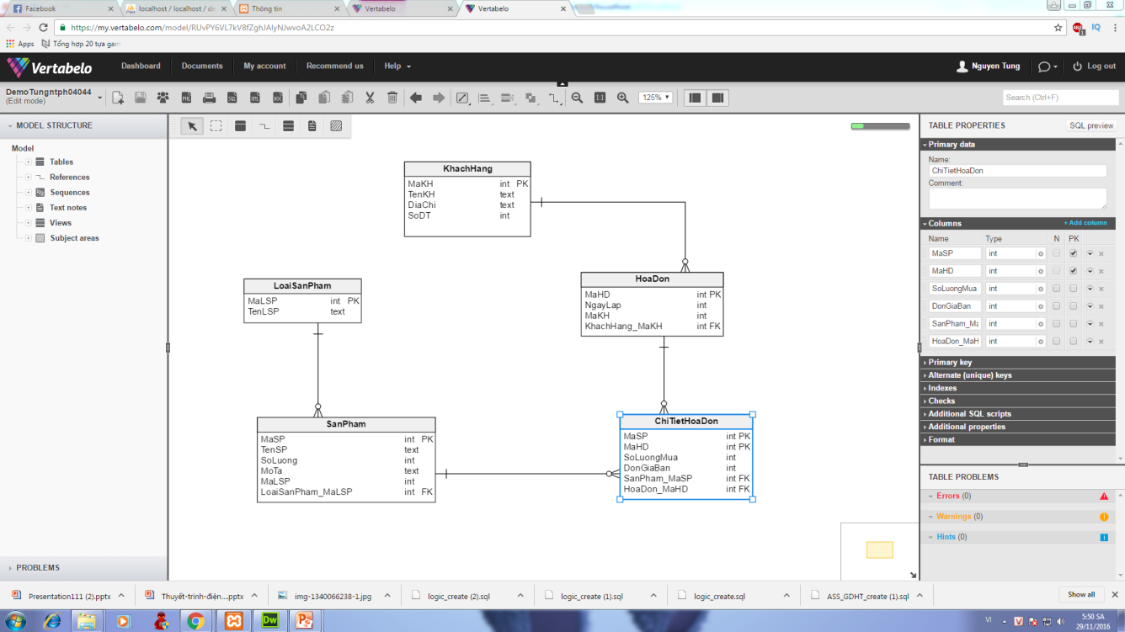
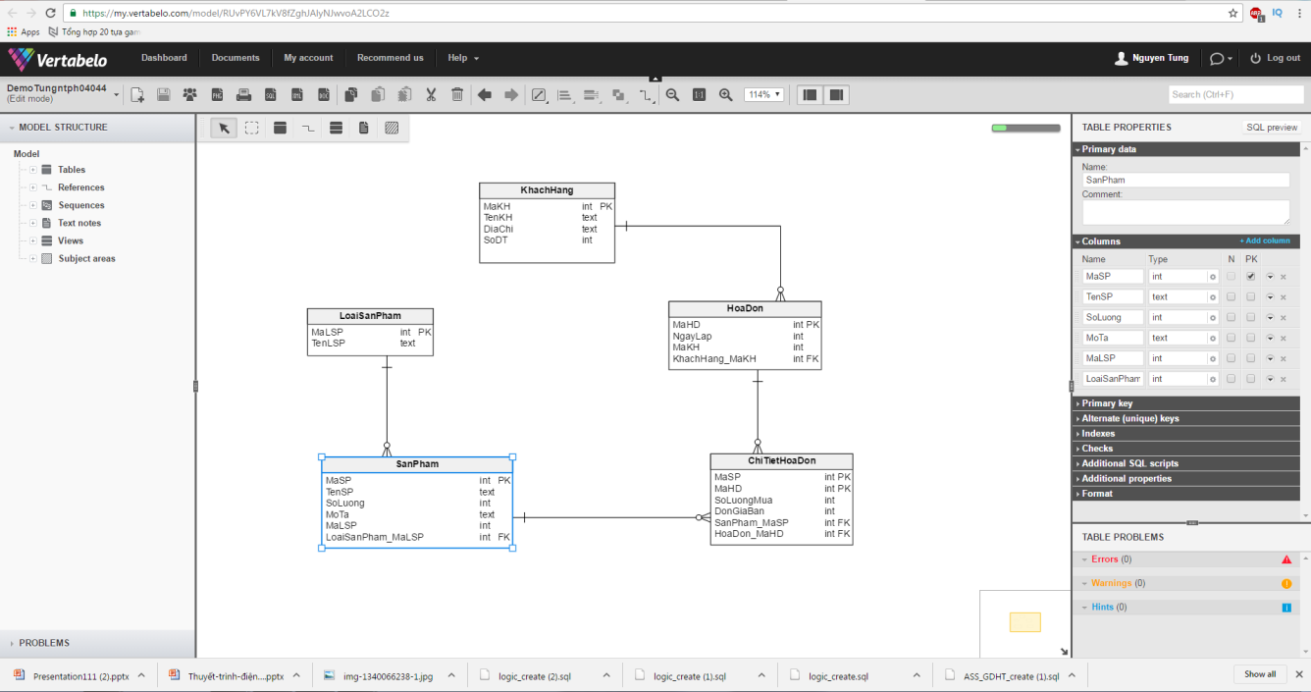
III. Vertabelo
Notes:
Custom animation effects: faded zoom entrance and exit (Basic)
To reproduce the picture effects on this slide, do the following:
On the Home tab, in the Slides group, click Layout, and then click Blank.
On the Insert tab, in the Illustrations group, click Picture. In the Insert Picture dialog box, select a picture, and then click Insert.
On the slide, select the picture. Under Picture Tools, on the Format tab, in the bottom right corner of the Size group, click the Size and Position dialog box launcher. In the Size and Position dialog box, on the Size tab, resize or crop the picture as needed so that under Size and rotate, the Height box is set to 5.5” and the Width box is set to 6.5”. Resize the picture under Size and rotate by entering values into the Height and Width boxes. Crop the picture under Crop from by entering values into the Left, Right, Top, and Bottom boxes.
Select the picture. Under Picture Tools, on the Format tab, in the Picture Styles group, click Picture Shape, and then under Rectangles click Rounded Rectangle (second option from the left).
On the picture, drag the yellow diamond adjustment handle toward the corner to decrease the rounding on the corners of the rectangle.
Under Picture Tools, on the Format tab, in the Picture Styles group, click Picture Effects, point to Shadow, and then under Outer click Offset Center (second row, second option from the left).
To reproduce the animation effects on this slide, do the following:
On the Animations tab, in the Animations group, click Custom Animation.
On the slide, select the picture. In the Custom Animation task pane, click Add Effect, point to Entrance, and then click More Effects. In the Add Entrance Effect dialog box, under Subtle, click Faded Zoom, and then click OK.
Under Modify: Faded Zoom, in the Start list, select With Previous.
Under Modify: Faded Zoom, in the Speed list, select Medium.
Also in the Custom Animation task pane, click Add Effect, point to Exit, and then click More Effects. In the Add Exit Effect dialog box, under Subtle, click Faded Zoom, and then click OK.
Under Modify: Faded Zoom, in the Start list, select On Click.
Under Modify: Faded Zoom, in the Speed list, select Medium.
To duplicate the animated picture effects on this slide, do the following:
Select the first picture. On the Home tab, in the Clipboard group, click the arrow under Paste, and then click Duplicate.
Select the second picture. Under Picture Tools, on the Format tab, in the Adjust group, click Change Picture. In the Insert Picture dialog box, select a picture, and then click Insert.
Select the second picture. Under Picture Tools, on the Format tab, in the bottom right corner of the Size group, click the Size and Position dialog box launcher. In the Size and Position dialog box, on the Size tab, resize or crop the picture as needed so that under Size and rotate, the Height box is set to 5.5” and the Width box is set to 6.5”. Resize the picture under Size and rotate by entering values into the Height and Width boxes. Crop the picture under Crop from by entering values into the Left, Right, Top, and Bottom boxes.
Select the second picture. On the Home tab, in the Clipboard group, click the arrow under Paste, and then click Duplicate.
Select the third picture. Under Picture Tools, on the Format tab, in the Adjust group, click Change Picture. In the Insert Picture dialog box, select a picture, and then click Insert.
Select the third picture. Under Picture Tools, on the Format tab, in the bottom right corner of the Size group, click the Size and Position dialog box launcher. In the Size and Position dialog box, on the Size tab, resize or crop the picture as needed so that under Size and rotate, the Height box is set to 5.5” and the Width box is set to 6.5”. Resize the picture under Size and rotate by entering values into the Height and Width boxes. Crop the picture under Crop from by entering values into the Left, Right, Top, and Bottom boxes.
Press and hold CTRL, and then select all three pictures. On the Home tab, in the Drawing group, click Arrange, point to Align, and then do the following:
Click Align to Slide.
Click Align Middle.
Click Align Center.
In the Custom Animation task pane, select the sixth animation effect (faded zoom exit effect for the third picture). Click the arrow to the right of the effect, and then click Remove.
To reproduce the background effects on this slide, do the following:
Right-click the slide background area, and then click Format Background. In the Format Background dialog box, click Fill in the left pane, select Gradient fill in the Fill pane, and then do the following:
In the Type list, select Radial.
Click the button next to Direction, and then click From Center (third option from the left).
Under Gradient stops, click Add or Remove until two stops appear in the drop-down list.
Also under Gradient stops, customize the gradient stops as follows:
Select Stop 1 from the list, and then do the following:
In the Stop position box, enter 0%.
Click the button next to Color, and then under Theme Colors click Black, Text 1, Lighter 50% (second row, second option from the left).
Select Stop 2 from the list, and then do the following:
In the Stop position box, enter 100%.
Click the button next to Color, and then under Theme Colors click Black, Text 1 (first row, second option from the left).

Slide 5
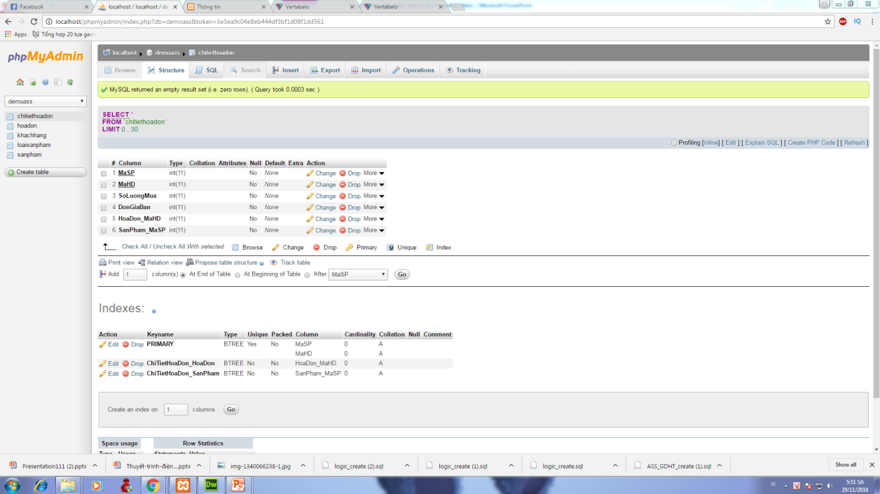
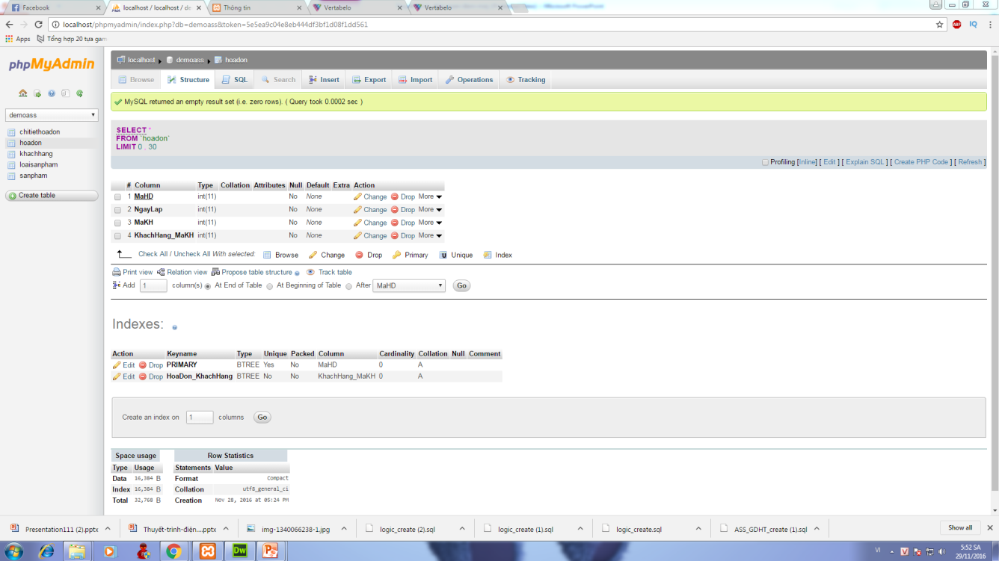
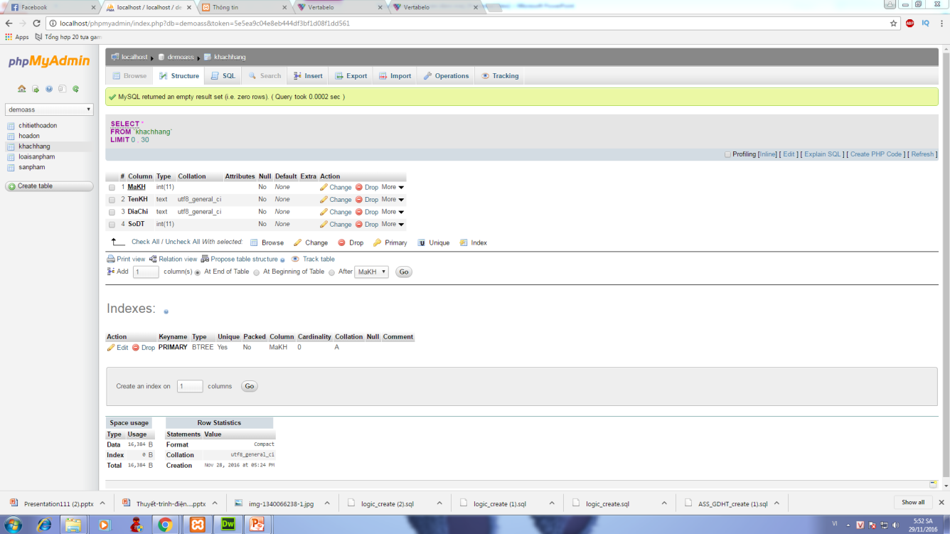
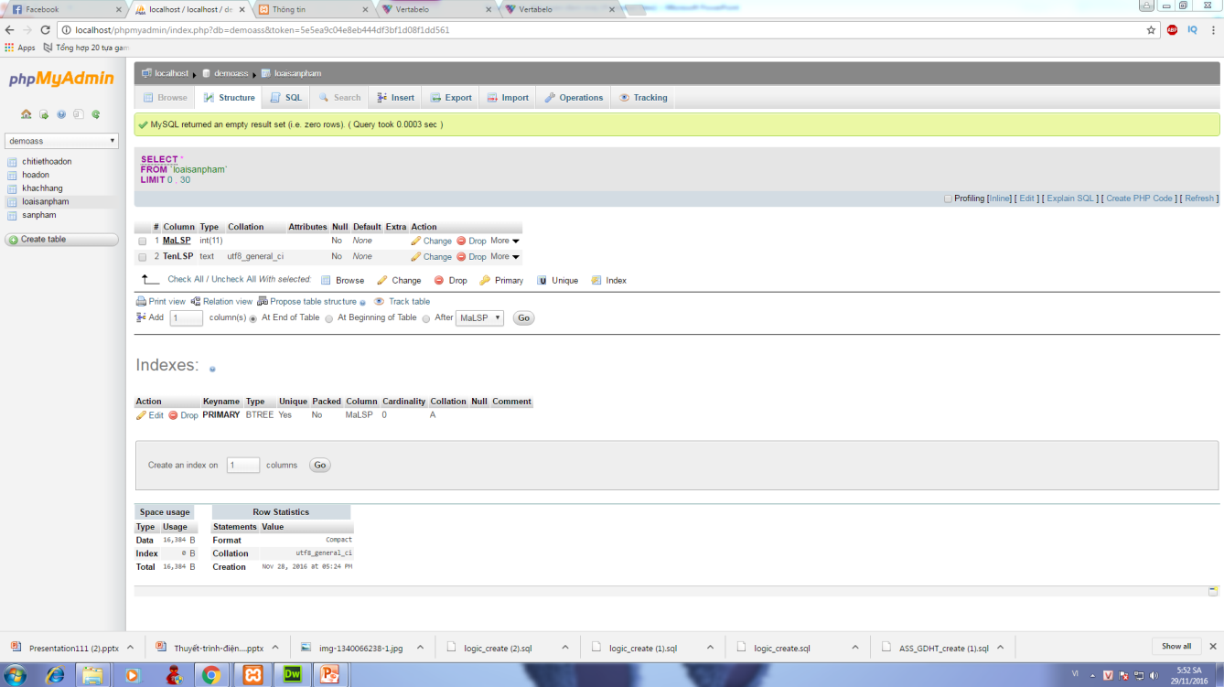
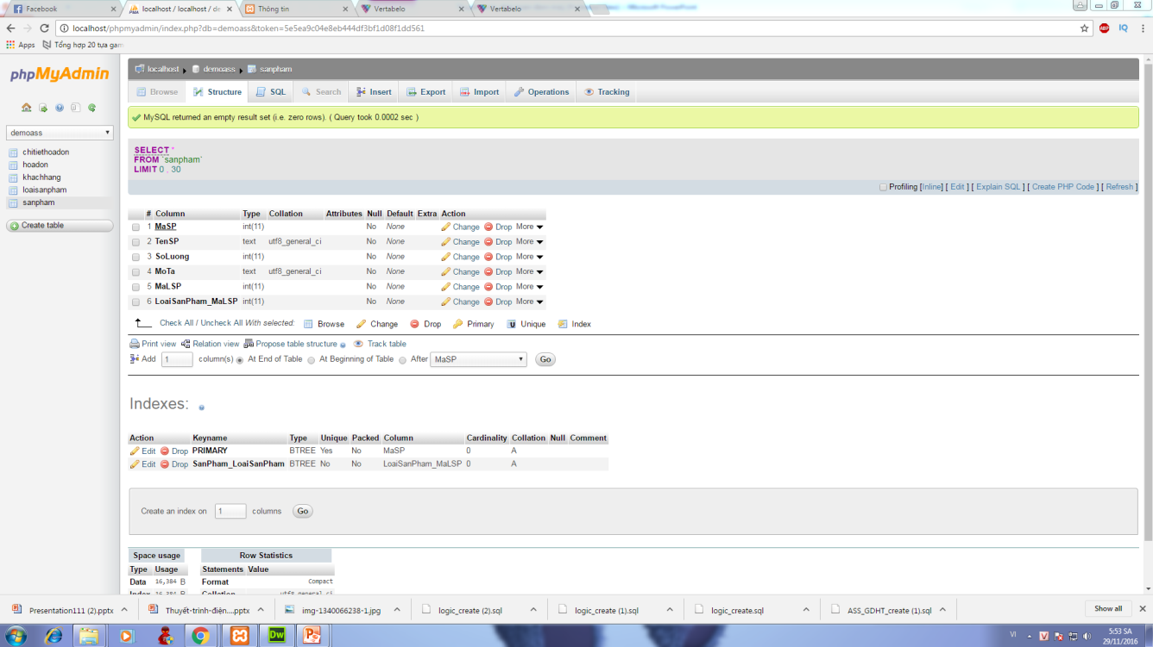
IV. Database
Notes:
Custom animation effects: faded zoom entrance and exit (Basic)
To reproduce the picture effects on this slide, do the following:
On the Home tab, in the Slides group, click Layout, and then click Blank.
On the Insert tab, in the Illustrations group, click Picture. In the Insert Picture dialog box, select a picture, and then click Insert.
On the slide, select the picture. Under Picture Tools, on the Format tab, in the bottom right corner of the Size group, click the Size and Position dialog box launcher. In the Size and Position dialog box, on the Size tab, resize or crop the picture as needed so that under Size and rotate, the Height box is set to 5.5” and the Width box is set to 6.5”. Resize the picture under Size and rotate by entering values into the Height and Width boxes. Crop the picture under Crop from by entering values into the Left, Right, Top, and Bottom boxes.
Select the picture. Under Picture Tools, on the Format tab, in the Picture Styles group, click Picture Shape, and then under Rectangles click Rounded Rectangle (second option from the left).
On the picture, drag the yellow diamond adjustment handle toward the corner to decrease the rounding on the corners of the rectangle.
Under Picture Tools, on the Format tab, in the Picture Styles group, click Picture Effects, point to Shadow, and then under Outer click Offset Center (second row, second option from the left).
To reproduce the animation effects on this slide, do the following:
On the Animations tab, in the Animations group, click Custom Animation.
On the slide, select the picture. In the Custom Animation task pane, click Add Effect, point to Entrance, and then click More Effects. In the Add Entrance Effect dialog box, under Subtle, click Faded Zoom, and then click OK.
Under Modify: Faded Zoom, in the Start list, select With Previous.
Under Modify: Faded Zoom, in the Speed list, select Medium.
Also in the Custom Animation task pane, click Add Effect, point to Exit, and then click More Effects. In the Add Exit Effect dialog box, under Subtle, click Faded Zoom, and then click OK.
Under Modify: Faded Zoom, in the Start list, select On Click.
Under Modify: Faded Zoom, in the Speed list, select Medium.
To duplicate the animated picture effects on this slide, do the following:
Select the first picture. On the Home tab, in the Clipboard group, click the arrow under Paste, and then click Duplicate.
Select the second picture. Under Picture Tools, on the Format tab, in the Adjust group, click Change Picture. In the Insert Picture dialog box, select a picture, and then click Insert.
Select the second picture. Under Picture Tools, on the Format tab, in the bottom right corner of the Size group, click the Size and Position dialog box launcher. In the Size and Position dialog box, on the Size tab, resize or crop the picture as needed so that under Size and rotate, the Height box is set to 5.5” and the Width box is set to 6.5”. Resize the picture under Size and rotate by entering values into the Height and Width boxes. Crop the picture under Crop from by entering values into the Left, Right, Top, and Bottom boxes.
Select the second picture. On the Home tab, in the Clipboard group, click the arrow under Paste, and then click Duplicate.
Select the third picture. Under Picture Tools, on the Format tab, in the Adjust group, click Change Picture. In the Insert Picture dialog box, select a picture, and then click Insert.
Select the third picture. Under Picture Tools, on the Format tab, in the bottom right corner of the Size group, click the Size and Position dialog box launcher. In the Size and Position dialog box, on the Size tab, resize or crop the picture as needed so that under Size and rotate, the Height box is set to 5.5” and the Width box is set to 6.5”. Resize the picture under Size and rotate by entering values into the Height and Width boxes. Crop the picture under Crop from by entering values into the Left, Right, Top, and Bottom boxes.
Press and hold CTRL, and then select all three pictures. On the Home tab, in the Drawing group, click Arrange, point to Align, and then do the following:
Click Align to Slide.
Click Align Middle.
Click Align Center.
In the Custom Animation task pane, select the sixth animation effect (faded zoom exit effect for the third picture). Click the arrow to the right of the effect, and then click Remove.
To reproduce the background effects on this slide, do the following:
Right-click the slide background area, and then click Format Background. In the Format Background dialog box, click Fill in the left pane, select Gradient fill in the Fill pane, and then do the following:
In the Type list, select Radial.
Click the button next to Direction, and then click From Center (third option from the left).
Under Gradient stops, click Add or Remove until two stops appear in the drop-down list.
Also under Gradient stops, customize the gradient stops as follows:
Select Stop 1 from the list, and then do the following:
In the Stop position box, enter 0%.
Click the button next to Color, and then under Theme Colors click Black, Text 1, Lighter 50% (second row, second option from the left).
Select Stop 2 from the list, and then do the following:
In the Stop position box, enter 100%.
Click the button next to Color, and then under Theme Colors click Black, Text 1 (first row, second option from the left).

Slide 6
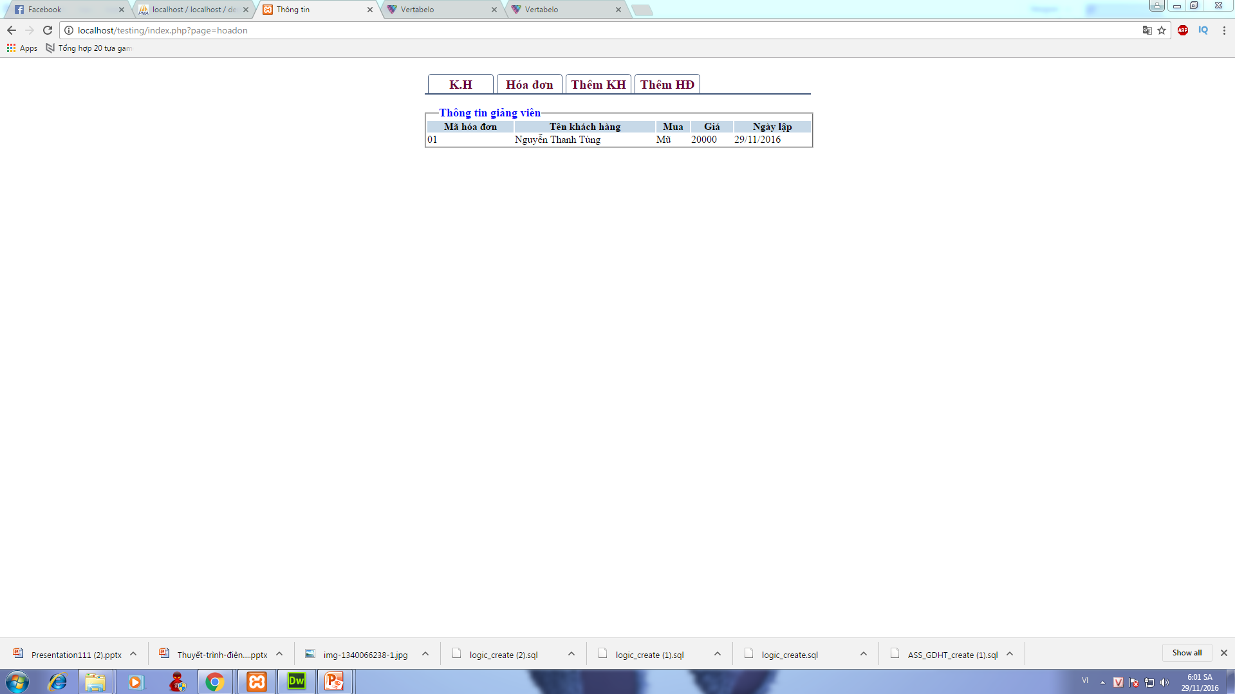
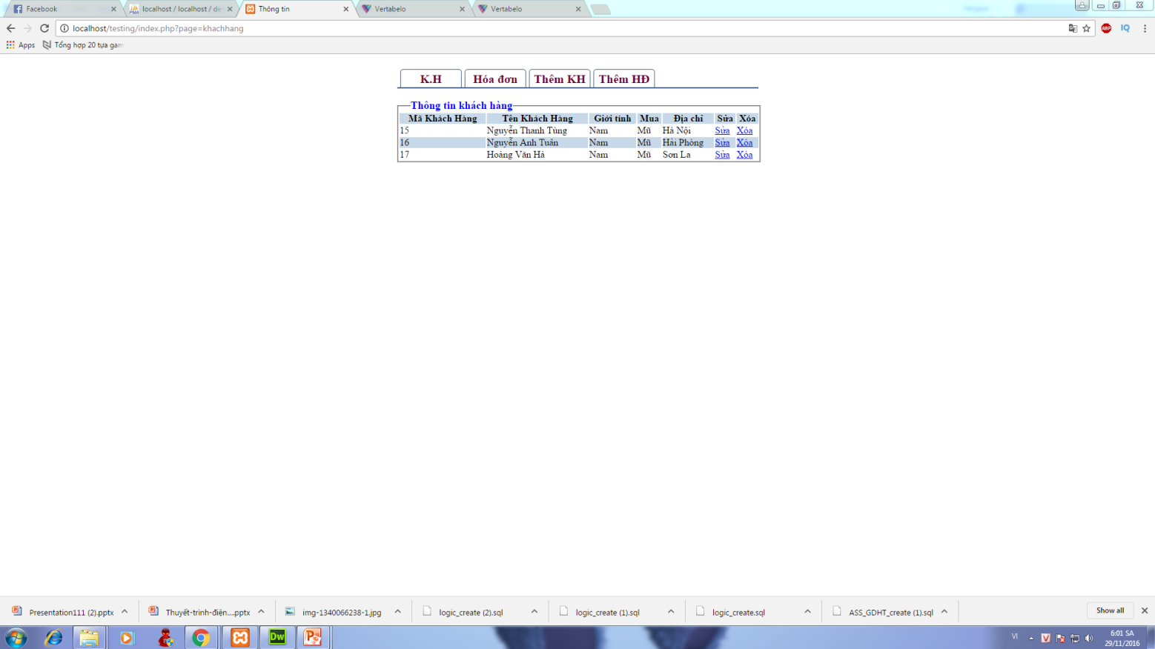
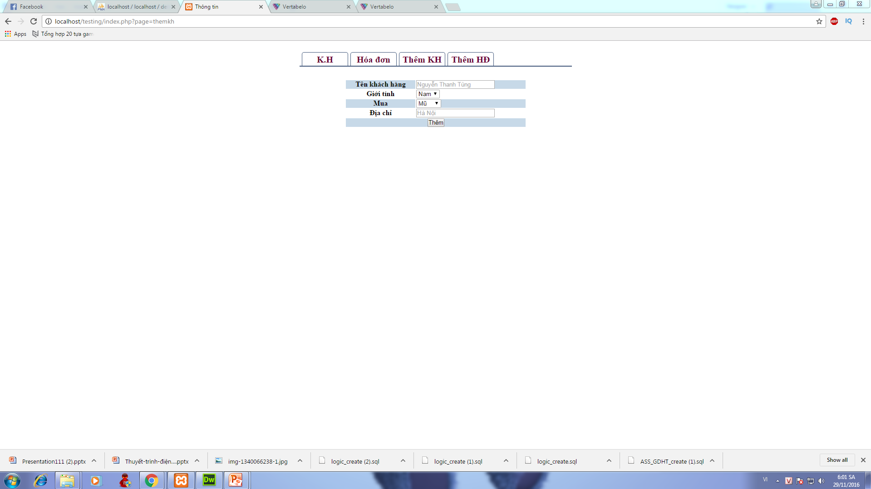
V. Mô hình nhập liệu
Notes:
Custom animation effects: faded zoom entrance and exit (Basic)
To reproduce the picture effects on this slide, do the following:
On the Home tab, in the Slides group, click Layout, and then click Blank.
On the Insert tab, in the Illustrations group, click Picture. In the Insert Picture dialog box, select a picture, and then click Insert.
On the slide, select the picture. Under Picture Tools, on the Format tab, in the bottom right corner of the Size group, click the Size and Position dialog box launcher. In the Size and Position dialog box, on the Size tab, resize or crop the picture as needed so that under Size and rotate, the Height box is set to 5.5” and the Width box is set to 6.5”. Resize the picture under Size and rotate by entering values into the Height and Width boxes. Crop the picture under Crop from by entering values into the Left, Right, Top, and Bottom boxes.
Select the picture. Under Picture Tools, on the Format tab, in the Picture Styles group, click Picture Shape, and then under Rectangles click Rounded Rectangle (second option from the left).
On the picture, drag the yellow diamond adjustment handle toward the corner to decrease the rounding on the corners of the rectangle.
Under Picture Tools, on the Format tab, in the Picture Styles group, click Picture Effects, point to Shadow, and then under Outer click Offset Center (second row, second option from the left).
To reproduce the animation effects on this slide, do the following:
On the Animations tab, in the Animations group, click Custom Animation.
On the slide, select the picture. In the Custom Animation task pane, click Add Effect, point to Entrance, and then click More Effects. In the Add Entrance Effect dialog box, under Subtle, click Faded Zoom, and then click OK.
Under Modify: Faded Zoom, in the Start list, select With Previous.
Under Modify: Faded Zoom, in the Speed list, select Medium.
Also in the Custom Animation task pane, click Add Effect, point to Exit, and then click More Effects. In the Add Exit Effect dialog box, under Subtle, click Faded Zoom, and then click OK.
Under Modify: Faded Zoom, in the Start list, select On Click.
Under Modify: Faded Zoom, in the Speed list, select Medium.
To duplicate the animated picture effects on this slide, do the following:
Select the first picture. On the Home tab, in the Clipboard group, click the arrow under Paste, and then click Duplicate.
Select the second picture. Under Picture Tools, on the Format tab, in the Adjust group, click Change Picture. In the Insert Picture dialog box, select a picture, and then click Insert.
Select the second picture. Under Picture Tools, on the Format tab, in the bottom right corner of the Size group, click the Size and Position dialog box launcher. In the Size and Position dialog box, on the Size tab, resize or crop the picture as needed so that under Size and rotate, the Height box is set to 5.5” and the Width box is set to 6.5”. Resize the picture under Size and rotate by entering values into the Height and Width boxes. Crop the picture under Crop from by entering values into the Left, Right, Top, and Bottom boxes.
Select the second picture. On the Home tab, in the Clipboard group, click the arrow under Paste, and then click Duplicate.
Select the third picture. Under Picture Tools, on the Format tab, in the Adjust group, click Change Picture. In the Insert Picture dialog box, select a picture, and then click Insert.
Select the third picture. Under Picture Tools, on the Format tab, in the bottom right corner of the Size group, click the Size and Position dialog box launcher. In the Size and Position dialog box, on the Size tab, resize or crop the picture as needed so that under Size and rotate, the Height box is set to 5.5” and the Width box is set to 6.5”. Resize the picture under Size and rotate by entering values into the Height and Width boxes. Crop the picture under Crop from by entering values into the Left, Right, Top, and Bottom boxes.
Press and hold CTRL, and then select all three pictures. On the Home tab, in the Drawing group, click Arrange, point to Align, and then do the following:
Click Align to Slide.
Click Align Middle.
Click Align Center.
In the Custom Animation task pane, select the sixth animation effect (faded zoom exit effect for the third picture). Click the arrow to the right of the effect, and then click Remove.
To reproduce the background effects on this slide, do the following:
Right-click the slide background area, and then click Format Background. In the Format Background dialog box, click Fill in the left pane, select Gradient fill in the Fill pane, and then do the following:
In the Type list, select Radial.
Click the button next to Direction, and then click From Center (third option from the left).
Under Gradient stops, click Add or Remove until two stops appear in the drop-down list.
Also under Gradient stops, customize the gradient stops as follows:
Select Stop 1 from the list, and then do the following:
In the Stop position box, enter 0%.
Click the button next to Color, and then under Theme Colors click Black, Text 1, Lighter 50% (second row, second option from the left).
Select Stop 2 from the list, and then do the following:
In the Stop position box, enter 100%.
Click the button next to Color, and then under Theme Colors click Black, Text 1 (first row, second option from the left).

Slide 7
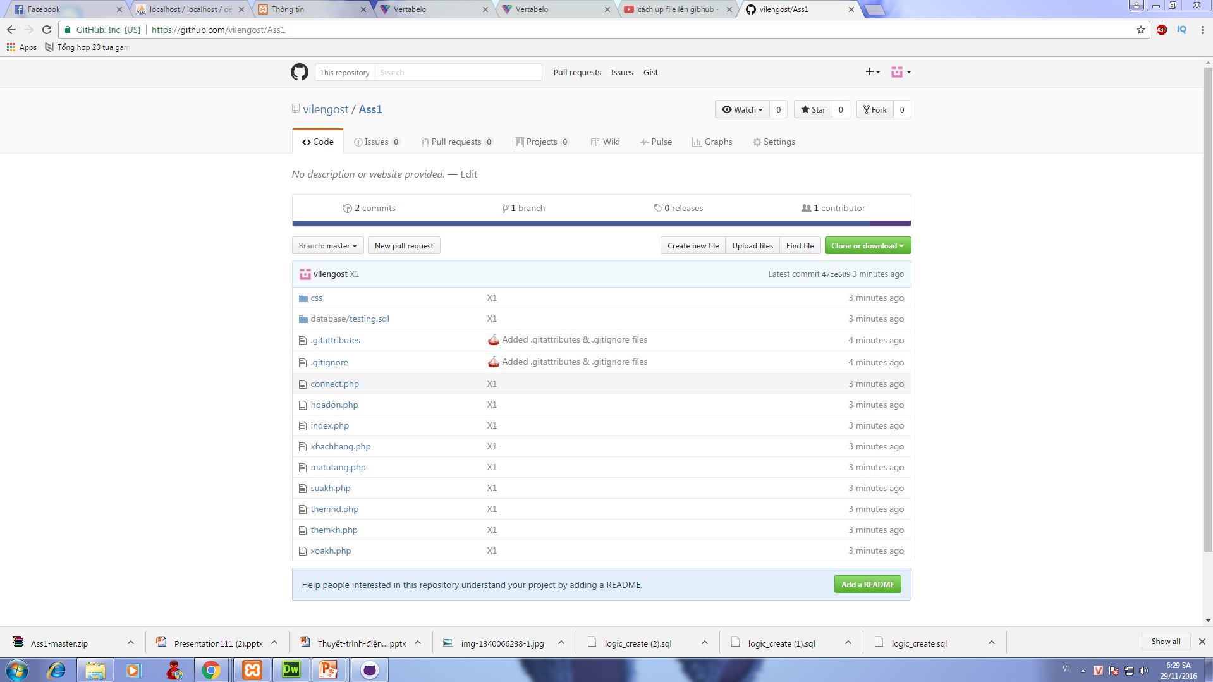

VI. GITHUB
Notes:
Custom animation effects: faded zoom entrance and exit (Basic)
To reproduce the picture effects on this slide, do the following:
On the Home tab, in the Slides group, click Layout, and then click Blank.
On the Insert tab, in the Illustrations group, click Picture. In the Insert Picture dialog box, select a picture, and then click Insert.
On the slide, select the picture. Under Picture Tools, on the Format tab, in the bottom right corner of the Size group, click the Size and Position dialog box launcher. In the Size and Position dialog box, on the Size tab, resize or crop the picture as needed so that under Size and rotate, the Height box is set to 5.5” and the Width box is set to 6.5”. Resize the picture under Size and rotate by entering values into the Height and Width boxes. Crop the picture under Crop from by entering values into the Left, Right, Top, and Bottom boxes.
Select the picture. Under Picture Tools, on the Format tab, in the Picture Styles group, click Picture Shape, and then under Rectangles click Rounded Rectangle (second option from the left).
On the picture, drag the yellow diamond adjustment handle toward the corner to decrease the rounding on the corners of the rectangle.
Under Picture Tools, on the Format tab, in the Picture Styles group, click Picture Effects, point to Shadow, and then under Outer click Offset Center (second row, second option from the left).
To reproduce the animation effects on this slide, do the following:
On the Animations tab, in the Animations group, click Custom Animation.
On the slide, select the picture. In the Custom Animation task pane, click Add Effect, point to Entrance, and then click More Effects. In the Add Entrance Effect dialog box, under Subtle, click Faded Zoom, and then click OK.
Under Modify: Faded Zoom, in the Start list, select With Previous.
Under Modify: Faded Zoom, in the Speed list, select Medium.
Also in the Custom Animation task pane, click Add Effect, point to Exit, and then click More Effects. In the Add Exit Effect dialog box, under Subtle, click Faded Zoom, and then click OK.
Under Modify: Faded Zoom, in the Start list, select On Click.
Under Modify: Faded Zoom, in the Speed list, select Medium.
To duplicate the animated picture effects on this slide, do the following:
Select the first picture. On the Home tab, in the Clipboard group, click the arrow under Paste, and then click Duplicate.
Select the second picture. Under Picture Tools, on the Format tab, in the Adjust group, click Change Picture. In the Insert Picture dialog box, select a picture, and then click Insert.
Select the second picture. Under Picture Tools, on the Format tab, in the bottom right corner of the Size group, click the Size and Position dialog box launcher. In the Size and Position dialog box, on the Size tab, resize or crop the picture as needed so that under Size and rotate, the Height box is set to 5.5” and the Width box is set to 6.5”. Resize the picture under Size and rotate by entering values into the Height and Width boxes. Crop the picture under Crop from by entering values into the Left, Right, Top, and Bottom boxes.
Select the second picture. On the Home tab, in the Clipboard group, click the arrow under Paste, and then click Duplicate.
Select the third picture. Under Picture Tools, on the Format tab, in the Adjust group, click Change Picture. In the Insert Picture dialog box, select a picture, and then click Insert.
Select the third picture. Under Picture Tools, on the Format tab, in the bottom right corner of the Size group, click the Size and Position dialog box launcher. In the Size and Position dialog box, on the Size tab, resize or crop the picture as needed so that under Size and rotate, the Height box is set to 5.5” and the Width box is set to 6.5”. Resize the picture under Size and rotate by entering values into the Height and Width boxes. Crop the picture under Crop from by entering values into the Left, Right, Top, and Bottom boxes.
Press and hold CTRL, and then select all three pictures. On the Home tab, in the Drawing group, click Arrange, point to Align, and then do the following:
Click Align to Slide.
Click Align Middle.
Click Align Center.
In the Custom Animation task pane, select the sixth animation effect (faded zoom exit effect for the third picture). Click the arrow to the right of the effect, and then click Remove.
To reproduce the background effects on this slide, do the following:
Right-click the slide background area, and then click Format Background. In the Format Background dialog box, click Fill in the left pane, select Gradient fill in the Fill pane, and then do the following:
In the Type list, select Radial.
Click the button next to Direction, and then click From Center (third option from the left).
Under Gradient stops, click Add or Remove until two stops appear in the drop-down list.
Also under Gradient stops, customize the gradient stops as follows:
Select Stop 1 from the list, and then do the following:
In the Stop position box, enter 0%.
Click the button next to Color, and then under Theme Colors click Black, Text 1, Lighter 50% (second row, second option from the left).
Select Stop 2 from the list, and then do the following:
In the Stop position box, enter 100%.
Click the button next to Color, and then under Theme Colors click Black, Text 1 (first row, second option from the left).

Slide 8

Goodbye

